Slide 1
How to CONTROL THE LIGHTs ?

Slide 2
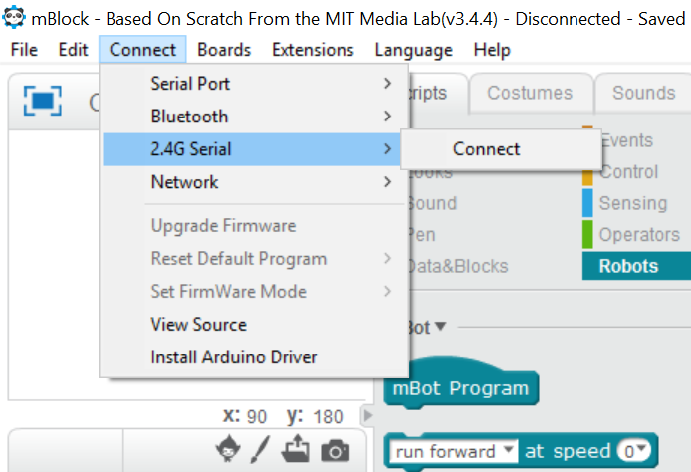
STEP 1.a LAUNCH THE MBLOCK
Start your mBlock application in your computer
Using the tools from the Events, Controls and Robot section, write the following code
GOTO Connect > 2.4G Serial > Connect

Slide 3
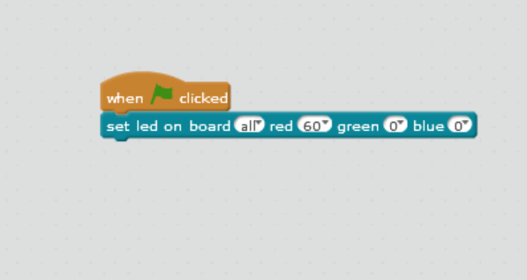
STEP 1.b MAKE ALL THE LIGHTS ‘RED’
Now add the ‘led on board’ command from the Robots section
Change the value of red from 0 to 60
This will make all the lights on board to glow red
Similarly, you can change them to blue and green

Slide 4
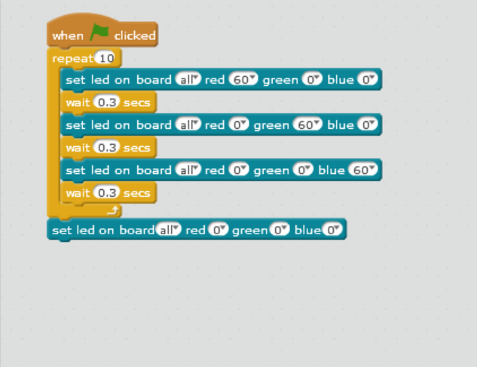
STEP 1.c GLOW ALTERNATE COLORS
Now, add ‘wait’ control followed by multiple color commands.
Your program should look like this !
Now press the flag icon on the left side top window.
Congrats, You got yourself a glowing robot !!

